Slide 1


Meraj Mohebi
January 7, 2024

Slide 2

Outline
Executive Summary
Introduction
Methodology
Results
Conclusion
Appendix

Slide 3
Executive Summary
Summary of methodologies
SpaceX Data Collection using SpaceX API
SpaceX Data Collection with Web Scraping
SpaceX Data Wrangling
SpaceX Exploratory Data Analysis using SQL
Space-X EDA DataViz Using Python Pandas and Matplotlib
Space-X Launch Sites Analysis with Folium-Interactive Visual Analytics and PlotyDash
SpaceX Machine Learning Landing Prediction
Summary of all results
EDA results
Interactive Visual Analytics and Dashboards
Predictive Analysis(Classification)

Slide 4
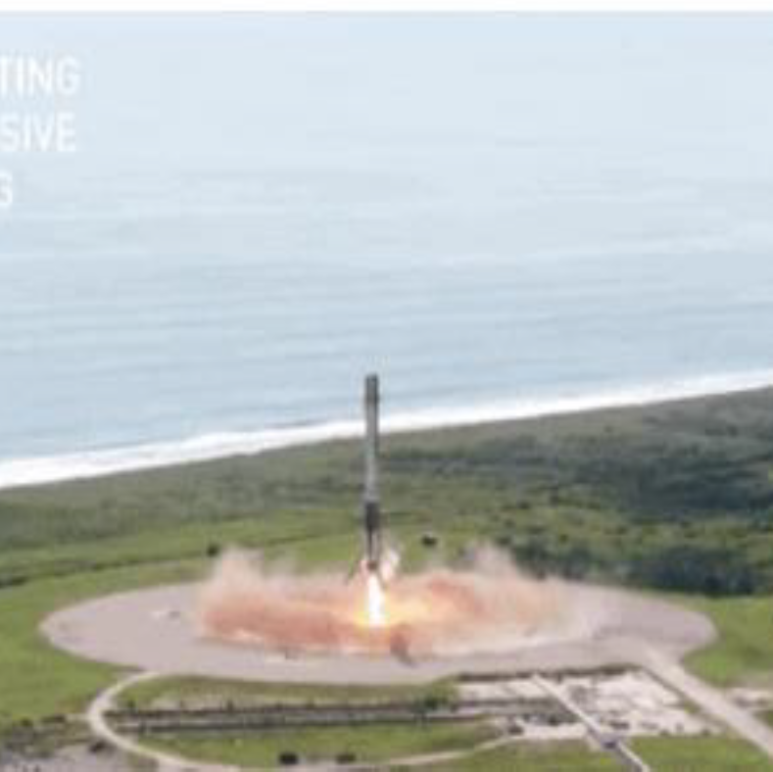
Introduction
Project background and context
SpaceX advertises Falcon 9 rocket launches on its website with a cost of 62 million dollars; other providers cost upward of 165 million dollars each, much of the savings is because SpaceX can reuse the first stage. Therefore, if we can determine if the first stage will land, we can determine the cost of a launch. This information can be used if an alternate company wants to bid against SpaceX for a rocket launch.
Problems you want to find answers
In this capstone, we will predict if the Falcon 9 first stage will land successfully using data from Falcon 9 rocket launches advertised on its website.

Slide 5

Section 1

Slide 6
Methodology
Executive Summary
Data collection methodology:
Describe how data was collected
Perform data wrangling
Describe how data was processed
Perform exploratory data analysis (EDA) using visualization and SQL
Perform interactive visual analytics using Folium and Plotly Dash
Perform predictive analysis using classification models
How to build, tune, evaluate classification models

Slide 7
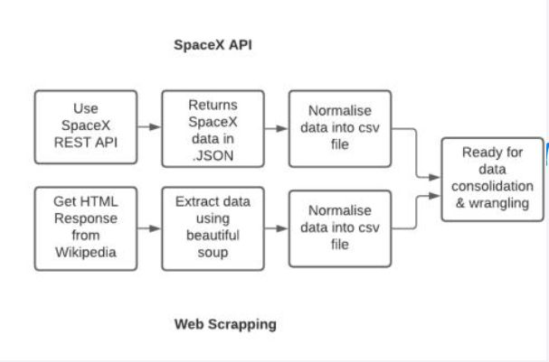
Data Collection
Description of how SpaceX Falcon9 data was collected.
Data was first collected using SpaceX API (a RESTful API) by making a get request to the SpaceX API. This was done by first defining a series helper functions that would help in the use of the API to extract information using identification numbers in the launch data and then requesting rocket launch data from the SpaceX API url.
Finally, to make the requested JSON results more consistent, the SpaceX launch data was requested and parsed using the GET request and then decoded the response content as a Json result which was then converted into a Pandas data frame.
Also performed web scraping to collect Falcon 9 historical launch records from a Wikipedia page titled List of Falcon 9 and Falcon Heavy launches of the launch records are stored in a HTML. Using Beautiful Soup and request Libraries, I extract the Falcon 9 launch HTML table records from the Wikipedia page, Parsed the table and converted it into a Pandas data frame

Slide 8
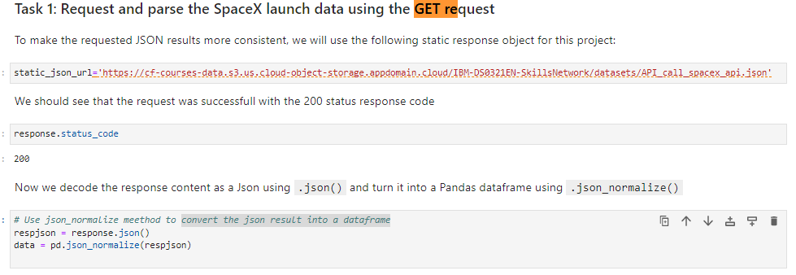
Data Collection – SpaceX API
Data collected using SpaceX API (a RESTful API) by making a get request to the SpaceX API then requested and parsed the SpaceX launch data using the GET request and decoded the response content as a Json result which was then converted into a Pandas data frame
Here is the GitHub URL of the completed SpaceX API calls notebook

Slide 9
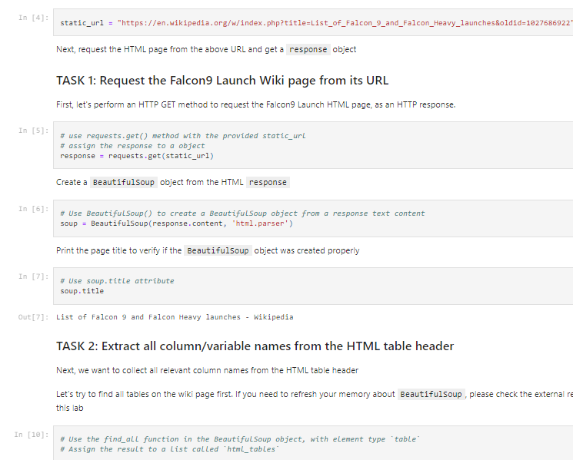
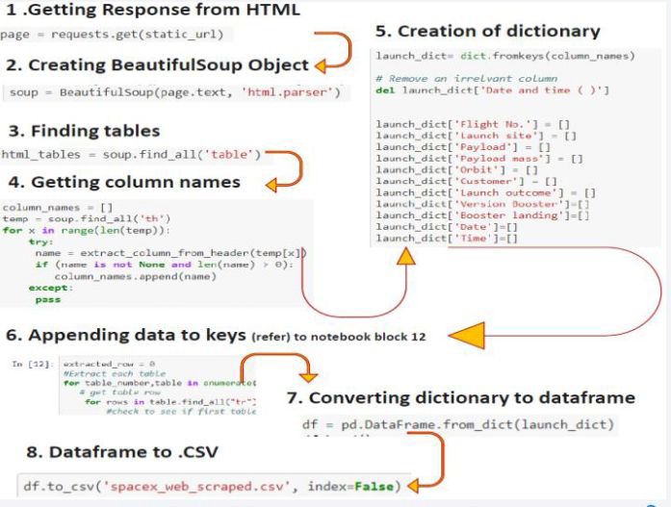
Data Collection - Scraping
Performed web scraping to collect Falcon 9 historical launch records from a Wikipedia using Beautiful Soup and request, to extract the Falcon 9 launch records from HTML table of the Wikipedia page, then created a data frame by parsing the launch HTML.
Here is the GitHub URL of the completed web scraping notebook.

Slide 10
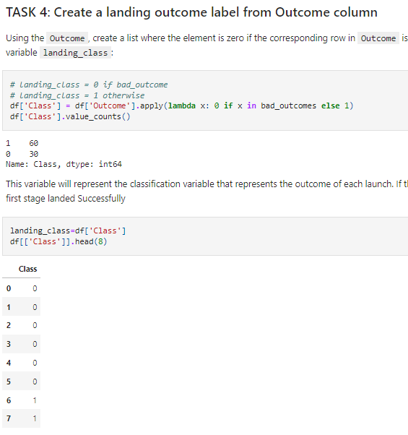
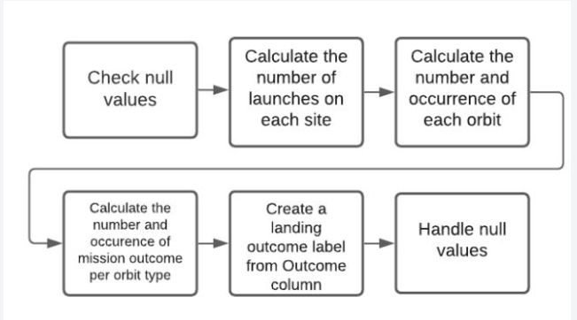
Data Wrangling
After obtaining and creating a Pandas DF from the collected data, data was filtered using the Booster Version column to only keep the Falcon 9 launches, then dealt with the missing data values in the Landing Pad and Payload Mass columns. For the Payload Mass, missing data values were replaced using mean value of column.
Also performed some Exploratory Data Analysis (EDA) to find some patterns in the data and determine what would be the label for training supervised models
Here is the GitHub URL of the completed data wrangling related notebooks.

Slide 11
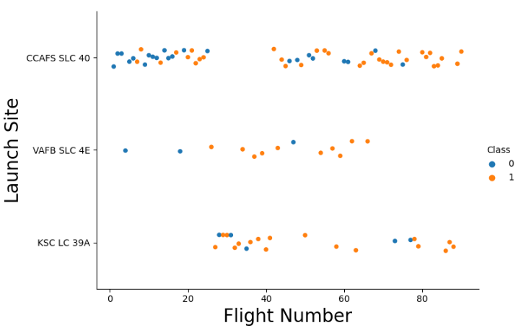
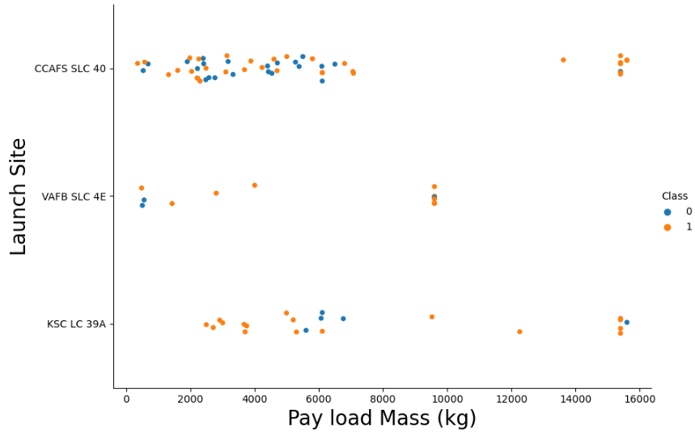
EDA with Data Visualization
Performed data Analysis and Feature Engineering using Pandas and Matplotlib.i.e.
Exploratory Data Analysis
Preparing Data Feature Engineering
Used scatter plots to Visualize the relationship between Flight Number and Launch Site, Payload and Launch Site, Flight Number and Orbit type, Payload and Orbit type.
Used Bar chart to Visualize the relationship between success rate of each orbit type
Line plot to Visualize the launch success yearly trend.
Here is the GitHub URL of your completed EDA with data visualization notebook.

Slide 12
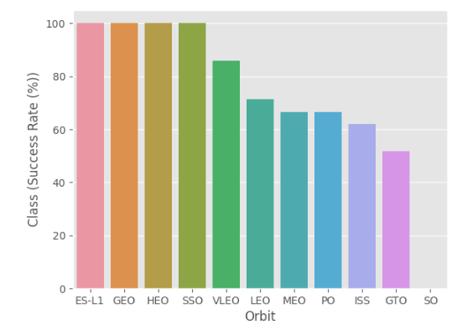
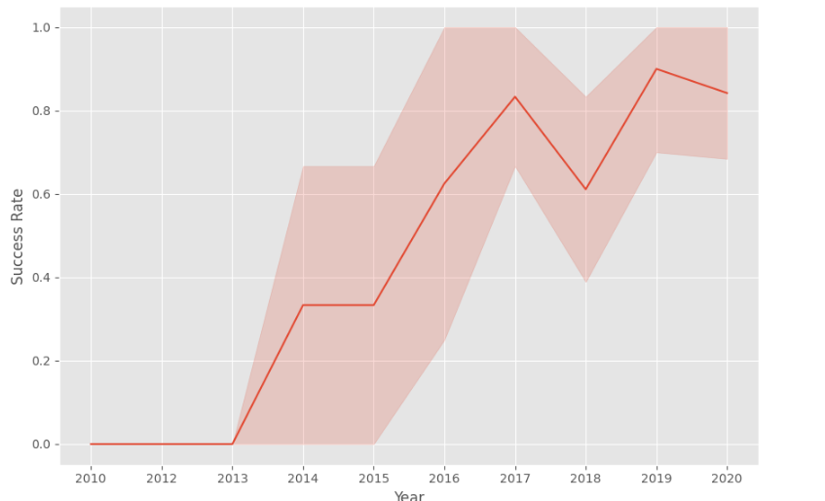
EDA with Data Visualization (continued)

Slide 13
EDA with SQL
The following SQL queries were performed for EDA
Display the names of the unique launch sites in the space mission
Display 5 records where launch sites begin with the string 'CCA‘
Display the total payload mass carried by boosters launched by NASA (CRS)
Display average payload mass carried by booster version F9 v1.1

Slide 14
EDA with SQL (continued)
•List the date when the first successful landing outcome in ground pad was achieved
•List the names of the boosters which have success in drone ship and have payload mass greater than 4000 but less than 6000
%sql SELECT DISTINCT Booster_Version, Payload FROM SPACEXTBL WHERE "Landing _Outcome" = "Success (drone ship)" AND PAYLOAD_MASS__KG_ > 4000 AND PAYLOAD_MASS__KG_ < 6000;
•List the total number of successful and failure mission outcomes
•Here is the GitHub URL of your completed EDA with SQL notebook.

Slide 15
Build an Interactive Map with Folium
Created folium map to mark all the launch sites along with map objects such as markers, circles, lines to mark the success or failure of launches for each launch site.
Created a launch set outcomes (failure=0 or success=1).
Here is the GitHub URL of the completed interactive map with Folium map, as an external reference and peer-review purpose.

Slide 16
Build a Dashboard with Plotly Dash
Built an interactive dashboard application with Plotlydash by:
Adding a Launch Site Drop-down Input Component
Adding a callback function to render success-pie-chart based on selected site dropdown
Adding a Range Slider to Select Payload
Adding a callback function to render the success-payload-scatter-chart scatter plot
Here is the GitHub URL of your completed Plotlydash lab.

Slide 17
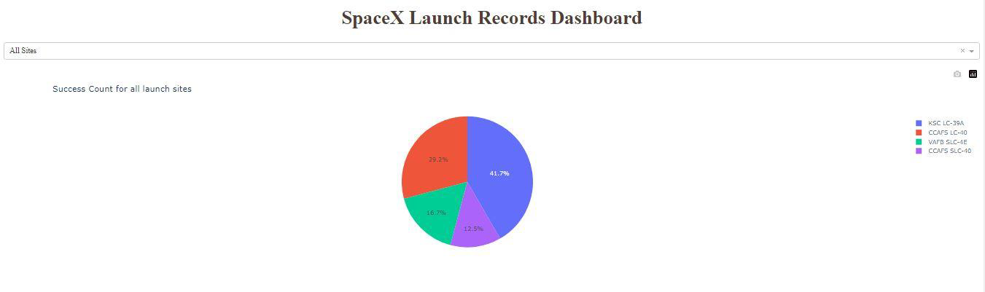
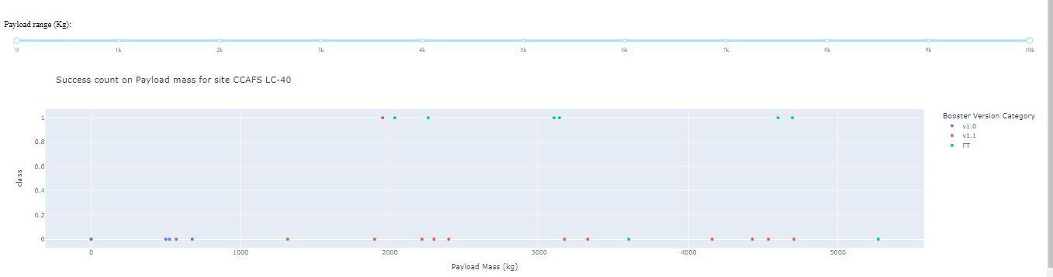
SpaceX Dash App

Slide 18
Predictive Analysis (Classification)
Summary of how I built, evaluated, improved, and found the best performing classification model
After loading the data as a Pandas Data frame, I set out to perform exploratory Data Analysis and determine Training Labels by;
Creating a NumPy array from the column Class in data, by applying the method to_numpy() then assigned it to the variable Y as the outcome variable.
Then standardized the feature dataset (x) by transforming it using preprocessing.StandardScaler() function from Sklearn.
After which the data was split into training and testing sets using the function train_test_split from sklearn.model_selection with the test_size parameter set to 0.2 and random_state to 2.

Slide 19
Predictive Analysis (Classification)
In order to find the best ML model/ method that would perform best using the test data between SVM, Classification Trees, k nearest neighbors and Logistic Regression;
First created an object for each of the algorithms then created a GridSearchCV object and assigned them a set of parameters for each model.
For each of the models under evaluation, the GridsearchCV object was created with cv=10, then fit the training data into the GridSearch object for each to Find best Hyperparameter.
After fitting the training set, we output GridSearchCV object for each of the models, then displayed the best parameters using the data attribute best_params_ and the accuracy on the validation data using the data attribute best_score.
Finally using the method score to calculate the accuracy on the test data for each model and plotted a confusion matrix for each using the test and predicted outcomes.

Slide 20
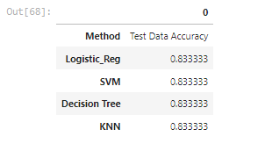
Predictive Analysis (Classification)
The table below shows the test data accuracy score for each of the methods SVM, Classification Trees, k nearest neighbors and Logistic Regression;
Here is the GitHub URL of the completed predictive analysis lab.

Slide 21

Section 2

Slide 22
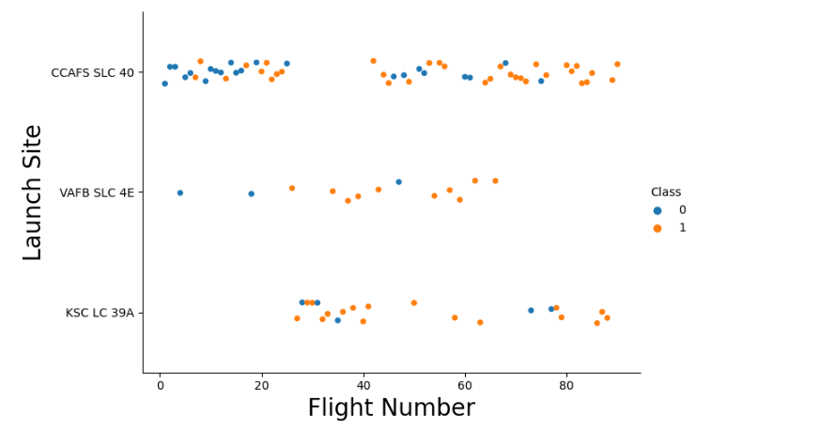
Flight Number vs. Launch Site
A scatter plot of Flight Number vs. Launch Site

Slide 23
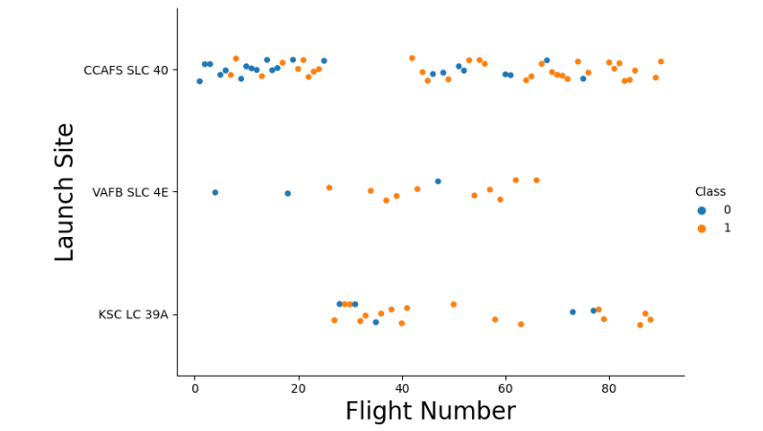
Flight Number vs. Launch Site
We can observe that as the flight number increases in each of the 3 launch sites, so does the success rate. For instance, the success rate for the VAFB SLC 4E launch site is 100% after the Flight number 50. Both KSC LC 39A and CCAFS SLC 40 have a 100% success rates after 80th flight.

Slide 24
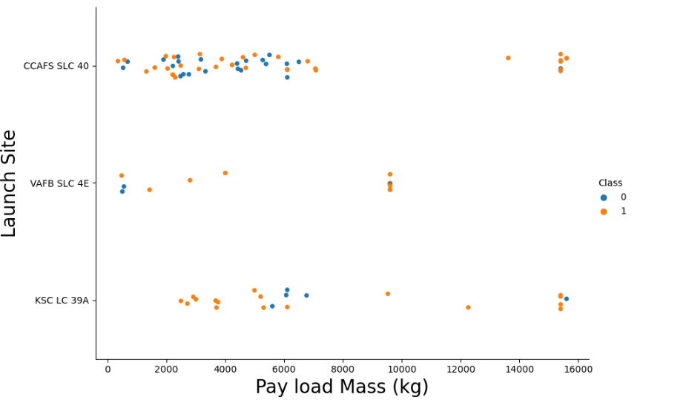
Payload vs. Launch Site

Slide 25
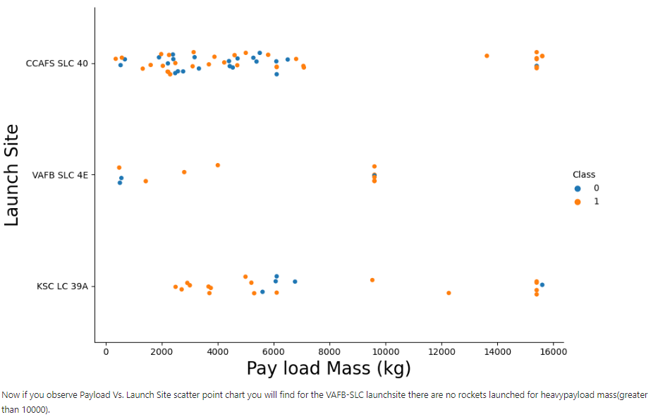
Payload vs. Launch Site
We can observe that for the VAFB-SLC launch site there are no rockets launched with heavy payload mass (greater than 10,000 Kg).

Slide 26
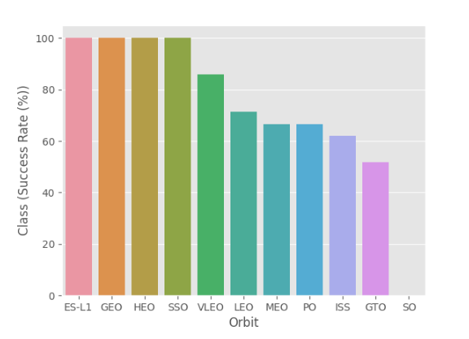
Success Rate vs. Orbit Type
Orbits ES-L1, GEO, HEO and SSO have the highest success rates at 100% with SO orbit having the lowest success rate at ~50% Orbit SO has 0% success rate.
A bar chart for the success rate of each orbit type

Slide 27
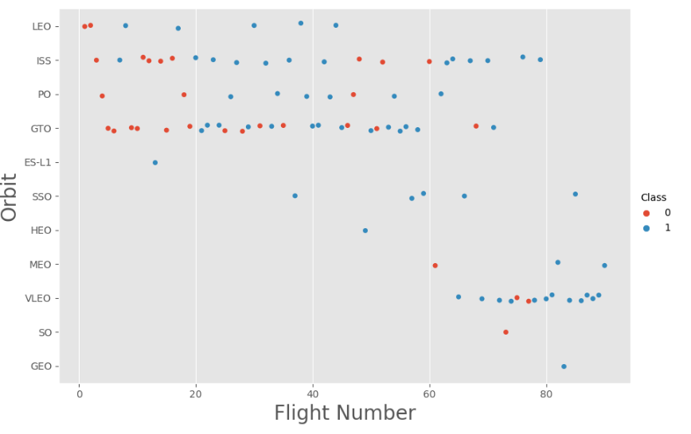
Flight Number vs. Orbit Type
The LEO orbit shows that the Success appears to be related to the number of flights; on the other hand, there seems to be no relationship between flight number when GTO orbit.
A scatter point of Flight number vs. Orbit type

Slide 28
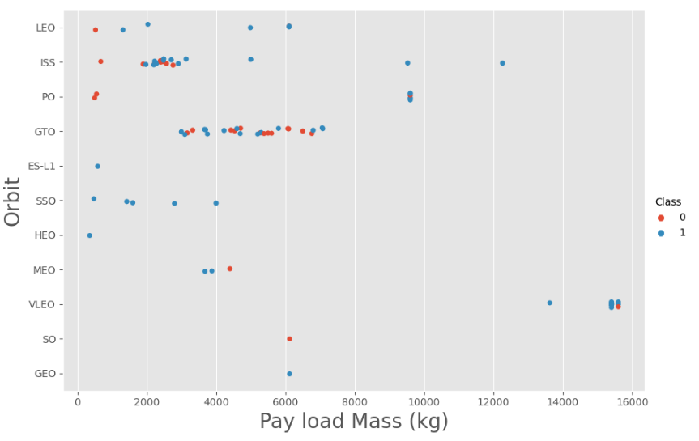
Payload vs. Orbit Type
With heavy payloads the successful landing or positive landing rate are more for Polar, LEO and ISS.
However, for GTO we cannot distinguish this well, as both positive landing rate and negative landing (unsuccessful mission) have nearly equal chances.

Slide 29
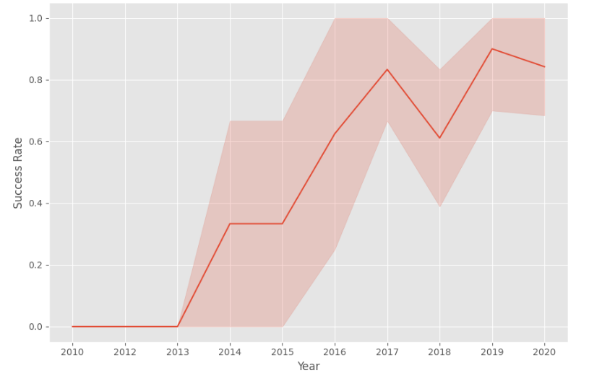
Launch Success Yearly Trend
Since 2013, the success rate has generally been increasing.

Slide 30
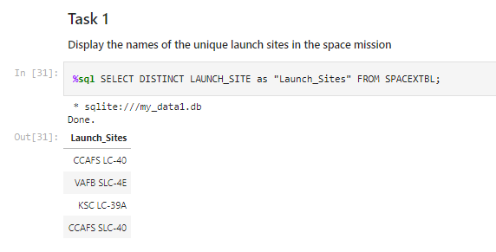
All Launch Site Names
Find the names of the unique launch sites
Used ‘SELECT DISTINCT’ statement to return only the unique launch sites from the ‘LAUNCH_SITE’ column of the SPACEXTBL table

Slide 31
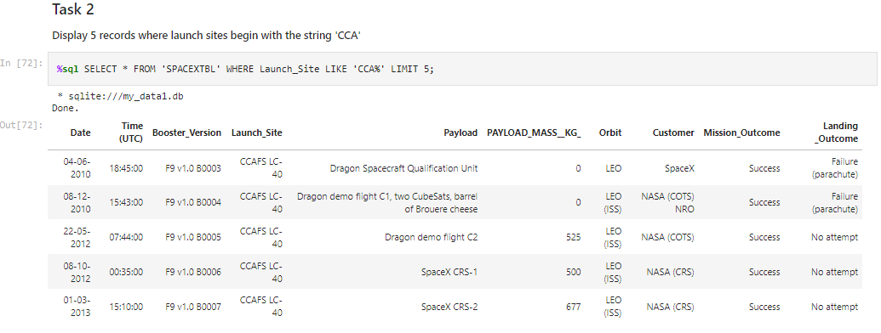
Launch Site Names Begin with 'CCA'
Find 5 records where launch sites begin with `CCA`
Used ‘LIKE’ command with ‘%’ wildcard in ‘WHERE’ clause to select and display a table of all records where launch sites begin with the string 'CCA'

Slide 32
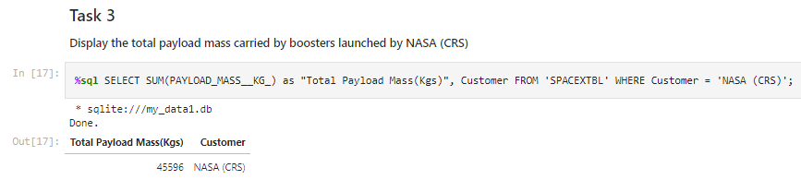
Total Payload Mass
Calculate the total payload carried by boosters from NASA
Used the ‘SUM()’ function to return and display the total sum of ‘PAYLOAD_MASS_KG’ column for Customer ‘NASA(CRS)’

Slide 33
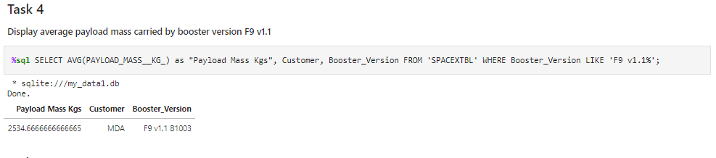
Average Payload Mass by F9 v1.1
Calculate the average payload mass carried by booster version F9 v1.1
Used the ‘AVG()’ function to return and dispaly the average payload mass carried by booster version F9 v1.1

Slide 34
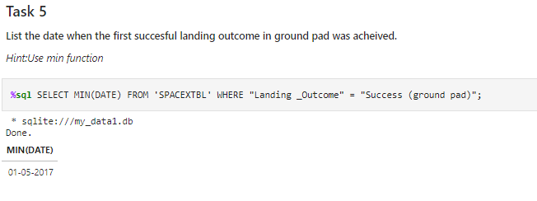
First Successful Ground Landing Date
Find the dates of the first successful landing outcome on ground pad
Used the ‘MIN()’ function to return and display the first (oldest) date when first successful landing outcome on ground pad ‘Success (ground pad)’ happened.

Slide 35
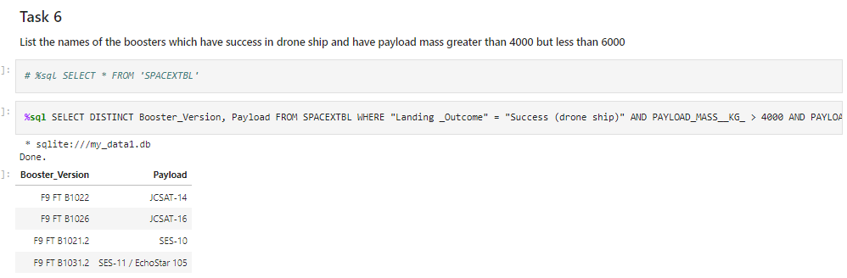
Successful Drone Ship Landing with Payload between 4000 and 6000
List the names of boosters which have successfully landed on drone ship and had payload mass greater than 4000 but less than 6000
Used ‘Select Distinct’ statement to return and list the ‘unique’ names of boosters with operators >4000 and <6000 to only list booster with payloads between 4000-6000 with landing outcome of ‘Success (drone ship)’.

Slide 36
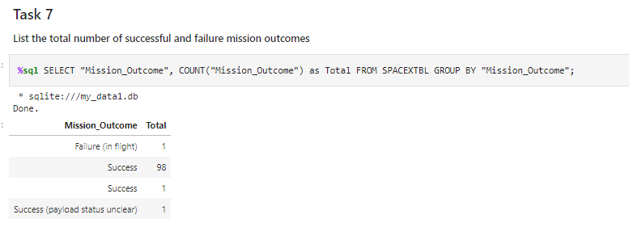
Total Number of Successful and Failure Mission Outcomes
Calculate the total number of successful and failure mission outcomes
Used the ‘COUNT()’ together with the ‘GROUP BY’ statement to return total number of missions outcomes.

Slide 37
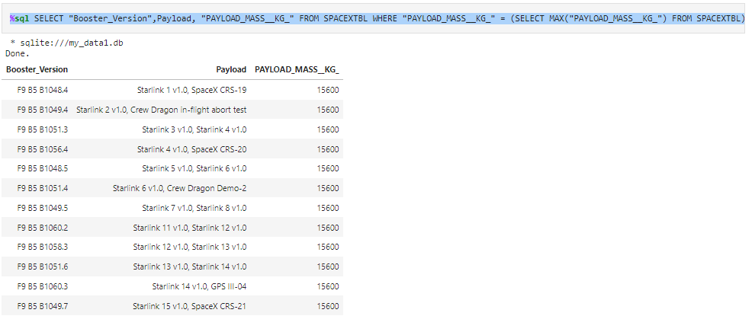
Boosters Carried Maximum Payload
List the names of the booster which have carried the maximum payload mass
Using a Subquery to return and pass the Max payload and listing all the boosters that have carried the Max payload of 15600kgs

Slide 38
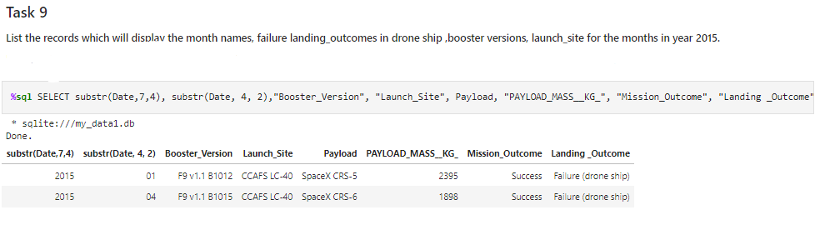
2015 Launch Records
List the failed landing outcomes in drone ship, their booster versions, and launch site names for in year 2015
Used the ‘subsrt()’ in the select statement to get the month and year from the date column where substr(Date,7,4)='2015' for year and Landing outcome was ‘Failure (drone ship’) and return the records matching the filter.

Slide 39
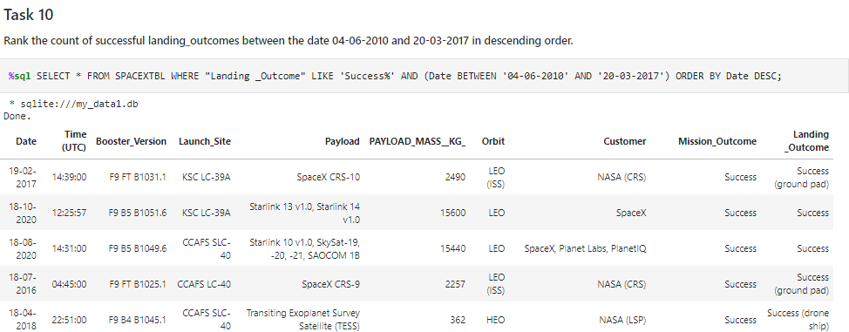
Rank Landing Outcomes Between 2010-06-04 and 2017-03-20
Rank the count of landing outcomes (such as Failure (drone ship) or Success (ground pad)) between the date 2010-06-04 and 2017-03-20, in descending order

Slide 40

Section 3

Slide 41
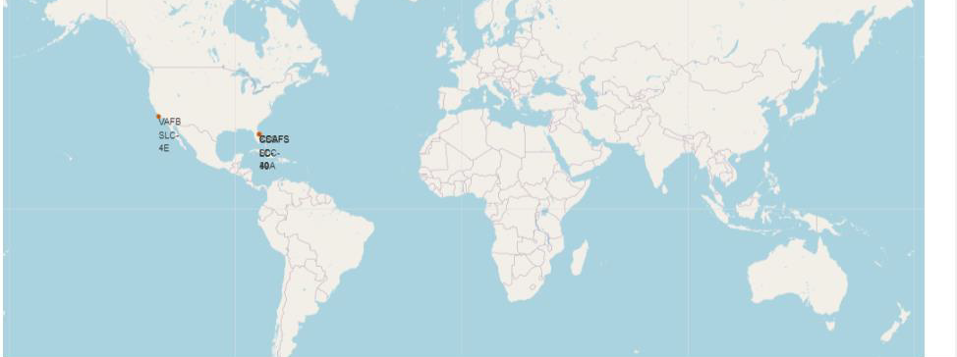
Markers of all launch sites on global map
All launch sites are in proximity to the Equator (located southwards of the US map). Also, all sites are in proximity to the coast.

Slide 42
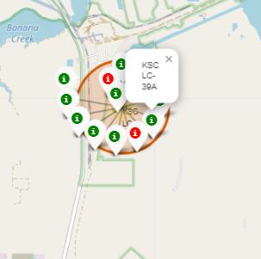
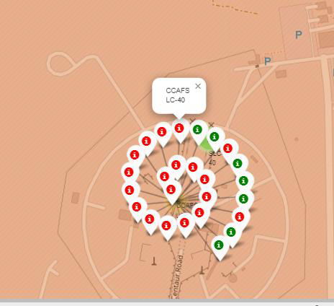
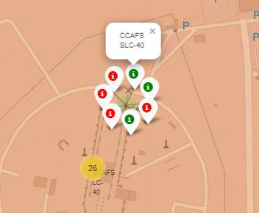
Florida
In the Eastern coast (Florida) launch site KSC LC-39A has relatively a high success rates compared to CCAFS SLC-40 & CCAFS LC-40.
Launch outcomes for each site on the map With Color Markers

Slide 43
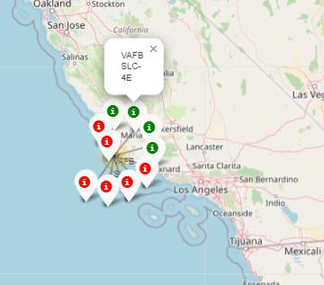
Launch outcomes for each site on the map With Color Markers
West Coast/ California
In the West Coast (California) Launch site VAFB SLC-4E has relatively lower success rates 4/10 compared to KSC LC-39A launch site in the Eastern Coast of Florida.

Slide 44
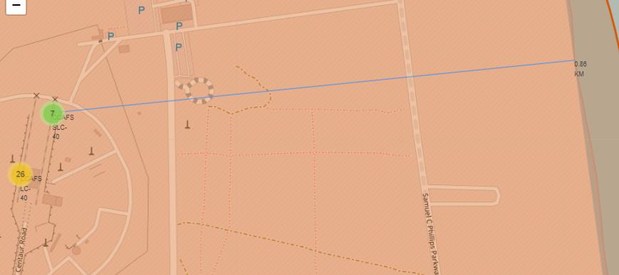
Distances between a launch site to its proximities
Launch site CCAFS SLC-40 proximity to coastline is 0.86km

Slide 45
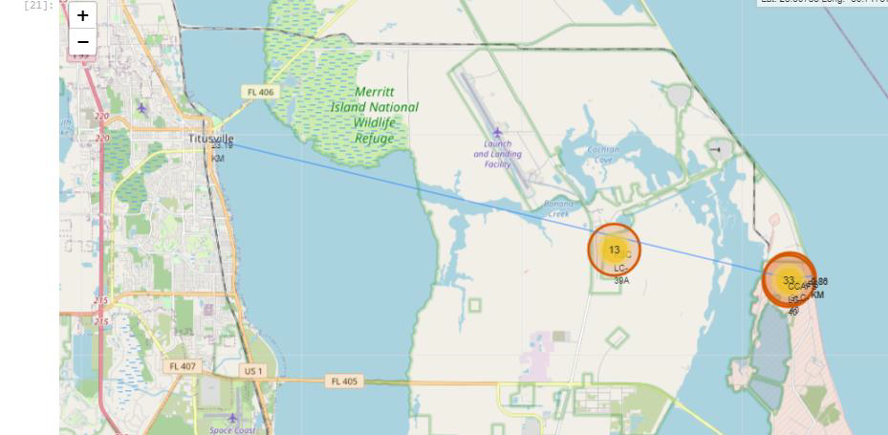
Distances between a launch site to its proximities
Launch site CCAFS SLC-40 distance to highway (Washington Avenue) is 23.19km

Slide 46

Section 4

Slide 47
Pie-Chart for launch success count for all sites
Launch site KSC LC-39A has the highest success rate at 42% followed by CCAFS LC-40 at 29%, VAFB SLC-4E at 17% and lastly CCAFS SLC-40 with a success rate of 13%

Slide 48
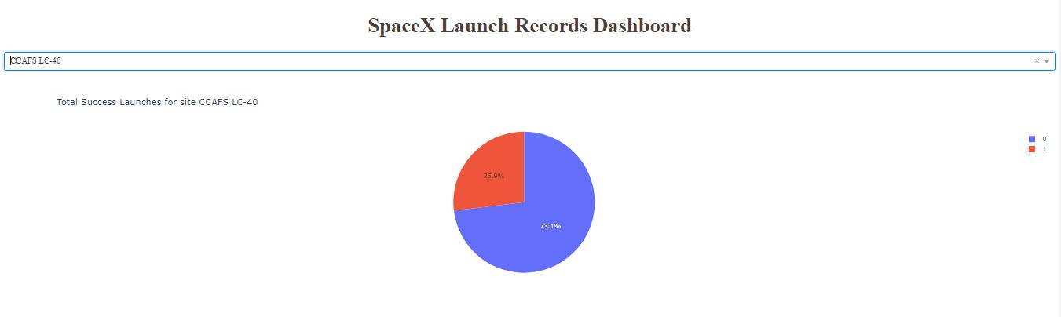
Pie chart for the launch site with 2nd highest launch success ratio
Launch site CCAFS LC-40 had the 2ndhighest success ratio of 73% success against 27% failed launches

Slide 49

Payload vs. Launch Outcome scatter plot for all sites
For Launch site CCAFS LC-40 the booster version FT has the largest success rate from a payload mass of >2000kg

Slide 50

Section 5

Slide 51
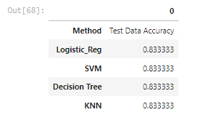
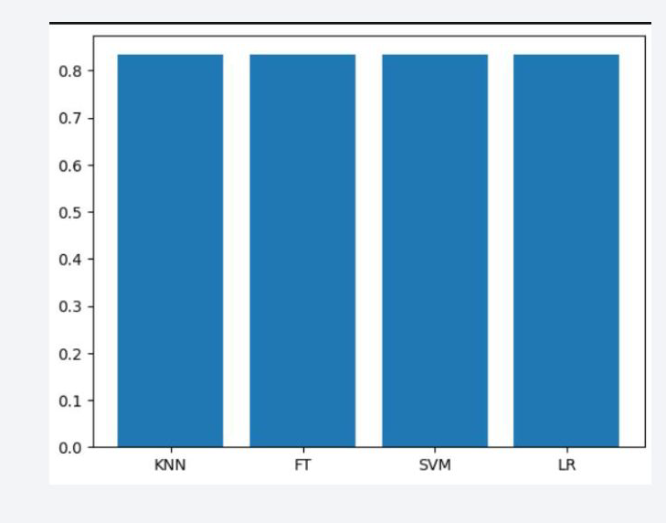
Classification Models Accuracy
All methods perform equally on the test data: i.e. they all have the same accuracy of 0.8333333 on the test data.

Slide 52
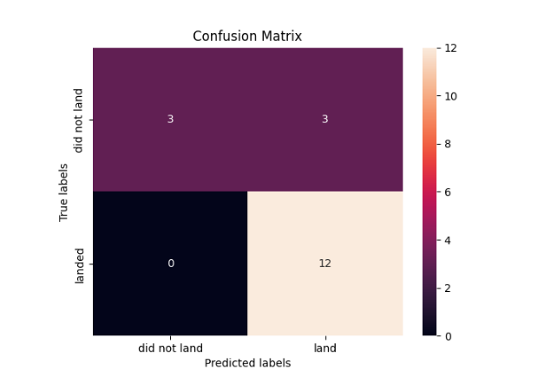
Confusion Matrix
All four classification models had the same confusion matrixes and were equally able to distinguish between the different classes.
The major problem is false positives for all the models.

Slide 53
Conclusions
Different launch sites have different success rates. CCAFS LC-40, has a success rate of 60 %, while KSC LC-39A and VAFB SLC 4E has a success rate of 77%.
We can deduce that, as the flight number increases in each of the 3 launch sites, so does the success rate. For instance, the success rate for the VAFB SLC 4E launch site is 100% after the Flight number 50. Both KSC LC 39A and CCAFS SLC 40 have a 100% success rates after 80th flight.
If you observe Payload Vs. Launch Site scatter point chart you will find for the VAFB-SLC launch site there are no rockets launched for heavy payload mass (greater than 10000).
Orbits ES-L1, GEO, HEO & SSO have the highest success rates at 100%, with SO orbit having the lowest success rate at ~50%. Orbit SO has 0% success rate.
LEO orbit the Success Rate appears to be related to the number of flights; on the other hand, there seems to be no relationship between flight number when in GTO orbit.

Slide 54
Conclusions (continued)
With heavy payloads the successful landing or positive landing rate are more for Polar, LEO and ISS.
However, for GTO we cannot distinguish this well, as both positive landing rate and negative landing (unsuccessful mission) have nearly equal chances.
And finally, the success rate since 2013 kept increasing until 2020.

Slide 55
Appendix
URLs of GitHub repositories embedded in the slides
https://github.com/mrjmhb/SpaceX-Falcon-9-Success-Landing-Prediction/blob/main/1.%20Space-X%20Data%20Collection%20API.ipynb
https://github.com/mrjmhb/SpaceX-Falcon-9-Success-Landing-Prediction/blob/main/2.%20Space-X%20Web%20scraping%20Falcon%209%20and%20Falcon%20Heavy%20Launches%20Records%20from%20Wikipedia.ipynb
https://github.com/mrjmhb/SpaceX-Falcon-9-Success-Landing-Prediction/blob/main/3.%20Space-X%20Data%20Wrangling%20spacex.ipynb
https://github.com/mrjmhb/SpaceX-Falcon-9-Success-Landing-Prediction/blob/main/4.%20Space-X%20EDA%20Using%20SQL.ipynb
https://github.com/mrjmhb/SpaceX-Falcon-9-Success-Landing-Prediction/blob/main/5.%20Space-X%20EDA%20DataViz%20Using%20Pandas%20and%20Matplotlib%20-%20SpaceX.ipynb
https://github.com/mrjmhb/SpaceX-Falcon-9-Success-Landing-Prediction/blob/main/6.Space-X%20Launch%20Sites%20Locations%20Analysis%20with%20Folium-Interactive%20Visual%20Analytics.ipynb
https://github.com/mrjmhb/SpaceX-Falcon-9-Success-Landing-Prediction/blob/main/7.%20Build%20an%20Interactive%20Dashboard%20with%20Ploty%20Dash%20-%20spacex_dash_app.py
https://github.com/mrjmhb/SpaceX-Falcon-9-Success-Landing-Prediction/blob/main/8.%20SpaceX%20Machine%20Learning%20Prediction.ipynb

Slide 56


